Slide 1
MATLAB
Lab Two exercises
Animation
Instructor: 黃世強 (Sai-Keung Wong)

Slide 2
About the demo video
A demo video may have bugs. The demo video shows roughly the results. These results may not be exactly the same as the requirements. They are for your own reference. You must follow the instruction to finish your programs.

Slide 3
Program file name format
Write all your programs in a folder. The folder name is your lab02_student_ID.
Zip the folder and upload it.
Write a program for each problem in one file.
The file name is lab02_X_yourStudentID.m, where X is the problem number.
For example, if your student ID is 12345678 and the problem number is 3, then the file name must be lab02_3_12345678.m.
Do not output all the intermediate results.
Output the results that are required only.

Slide 4
Clean up and show information
For each problem, display the problem number before showing the results.
% close all windows
% clear variables, and clear screen
close all; clear; clc;
% show Lab Two Example
disp('Lab Two Example')

Slide 5
At the top of the file, write down your name, ID, email address, department, and date.
%%%%%%%%%%%%%%%%%%%%%%%%%%%
% Assignment Number: Lab Two
% Problem number: …
% Student Name: …
% Student ID: …
% Email address: …
% Department: Computer Science, NYCU
% Date: ….
%%%%%%%%%%%%%%%%%%%%%%%%%%%%

Slide 6
Example. (See the source code)
Visualization of the projectile motion of a particle p. The update rules for the particle are as follows:
R1) v ← v + a Δt – d v % velocity
R2) p ← p + v Δt % position
R3) t ← t + Δt % time
Initial condition: t = 0, a = [-0.5 -1.5], v = [15 10], and p = [0 0].
p is a function of time. Δt = 0.05. m = 1. n = [0 -1].
The main process is as follows.
Ask to input d. If d is smaller than 0, quit the program. d is in [0, 1].
Clear the current figure.
Animate the point p. t in [0, 100]. Draw it as a blue (filled) circle.
Use pause(Δt). Set grid on. Set a proper range for the axis and y-axis so that the entire path of the point is visible.

Slide 7
Example
% draw it at (p(1), p(2))
% p(1) is the x-coordinate, and p(2) is the y-coordinate
%
viscircles([p(1) p(2)], 1, 'color', 'b'); % 1 is the radius
a = [-0.5 -1.5];
p = [0 0];
v = [5 10];
dt = 0.05; % the time step size Δt

Slide 8
How to make a figure stay on top?
Use a variable to store the figure handle:
h = figure;
To make the figure stay on top
figure(h);

Slide 9
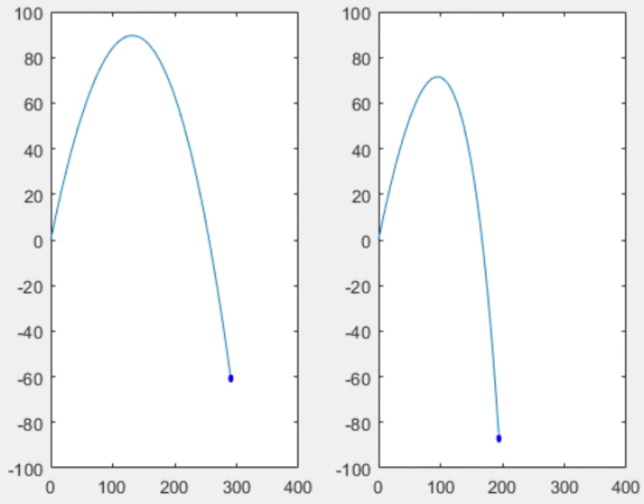
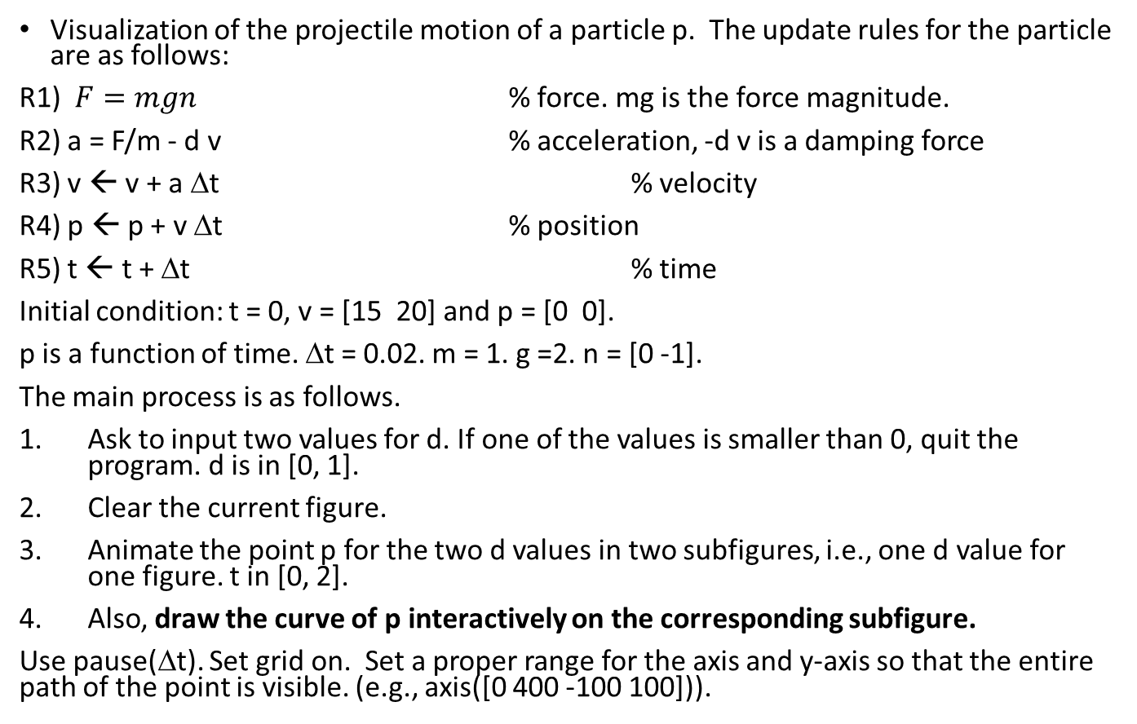
(50%) Lab Problem 2.1
Visualization of the projectile motion of a particle p. The update rules for the particle are as follows:
R1) $F=mgn$ % force. mg is the force magnitude.
R2) a = F/m - d v % acceleration, -d v is a damping force
R3) v ← v + a Δt % velocity
R4) p ← p + v Δt % position
R5) t ← t + Δt % time
Initial condition: t = 0, v = [15 20] and p = [0 0].
p is a function of time. Δt = 0.02. m = 1. g =2. n = [0 -1].
The main process is as follows.
Ask to input two values for d. If one of the values is smaller than 0, quit the program. d is in [0, 1].
Clear the current figure.
Animate the point p for the two d values in two subfigures, i.e., one d value for one figure. t in [0, 2].
Also, draw the curve of p interactively on the corresponding subfigure.
Use pause(Δt). Set grid on. Set a proper range for the axis and y-axis so that the entire path of the point is visible. (e.g., axis([0 400 -100 100])).

Slide 10
Lab Problem 2.1. Basic idea. But we need subplot
>Animate the point p. t in [0, 100].
To produce an animation, do the followings.
initialize the variables
while t <= tmax
perform the update rules to compute p
clf; plot(p(1), p(2), ‘o’); // if need more plots, use hold on
axis([ …]); // the ranges for the x- and y-axes.
pause(dt); // let the user see the result for dt second
end

Slide 11
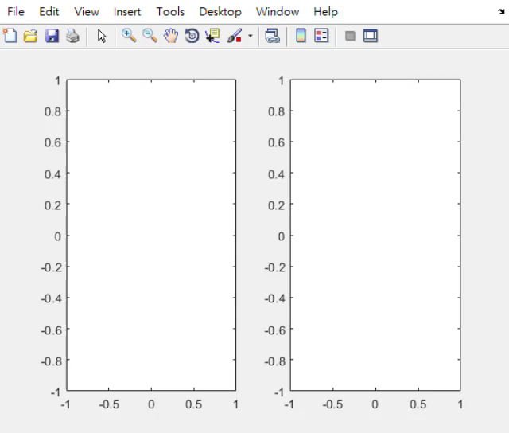
Problem 2.1
d=0.01
d=0.05

Slide 12
(50%) Lab Problem 2.2
Write a program to ask for inputs. Then it plots a function y = f(x). Also animate a point moving along the curve.
The function y = |x| + a sin(x). The process is stated as follows.
Clear the screen. Show your student ID and name.
Ask to input a. Assume that a is inside[-10, 10].
If a is zero, show a message “Thanks for playing.” and then quit the program. Otherwise go to step 4.
Ask to input the step size, dx, of x. if dx is zero, set it to a default value 0.05. if dx <0 or dx > 1, show ‘dx must be inside (0, 1]’. dx must be inside (0, 1].
Plot y versus x. x is inside [-10, 10]. The step size of x is dx. The line width of the curve is set to 3.
Then animate a point moving along the curve, starting from x = -10 to x = 10 with step size 0.025. Set the pause duration properly. Turn on the grid.

Slide 13
Lab Problem 2.2
Use
plot(x0, y0, 'o', 'color', 'r');
To plot the moving point.
Do you know the difference between viscircles and a plot with ‘o’?

Slide 14
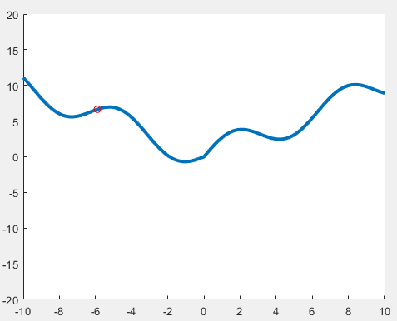
Lab Problem 2.2
axis([-10 10 -20 20]);
a = 2;

Slide 15
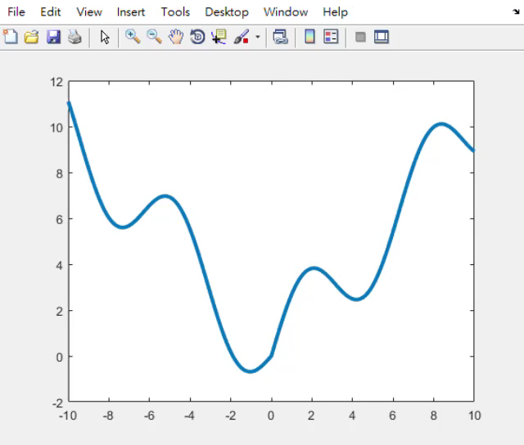

Slide 16
End
Enjoy MATLAB Programming.

